Slide 1
CONTENTS
Evolutionary model
Spiral models

Slide 2
Evolutionary Process Models
Evolutionary model is a combination of Iterative and Incremental model of software development life cycle.
Evolutionary model is also referred to as the successive versions model and sometimes as the incremental model. In Evolutionary model, the software requirement is first broken down into several modules (or functional units) that can be incrementally constructed and delivered.

Slide 3
Evolutionary Process Models
The development first develops the core modules of the system. The core modules are those that do not need services from the other modules.
The evolutionary model is normally useful for very large products, where it is easier to find modules for incremental implementation.
The evolutionary model shown in Figure below . Each successive version/model of the product is a fully functioning software capable of performing more work than the previous versions/model.

Slide 4
Evolutionary Process Models

Slide 5
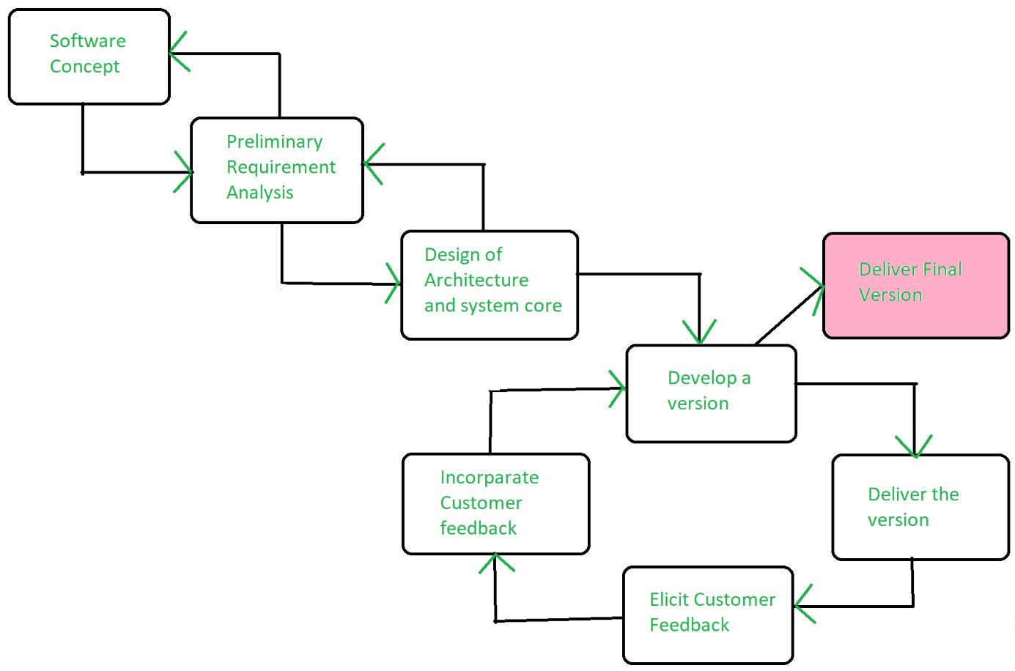
Evolutionary Process Model

Slide 6
ADVANTAGES :
1. Large project: Evolutionary model is normally useful for very large products.
2. User gets a chance to experiment with a partially developed software much before the complete version of the system is released.
3. Evolutionary model helps to accurately elicit user requirements during the delivery of different versions of the software.
4. The core modules get tested thoroughly, thereby reducing the chances of errors in the core modules of the final products.
5. Evolutionary model avoids the need to commit large resources in one go for development of the system.

Slide 7
DISADVANTAGES :
1. Difficult to divide the problem into several versions that would be acceptable to the customer and which can be incrementally implemented and delivered.

Slide 8
Spiral Model
Spiral model is a combination of iterative development process model and sequential linear development model i.e. the waterfall model with a very high emphasis on risk analysis. It allows incremental releases of the product or incremental refinement through each iteration around the spiral.
The spiral model has four phases. A software project repeatedly passes through these phases in iterations called Spirals.
Each phase in spiral model begins with a design goal and ends with the client reviewing the progress.
The spiral model was first mentioned by Barry Boehm in his 1986 paper.

Slide 9
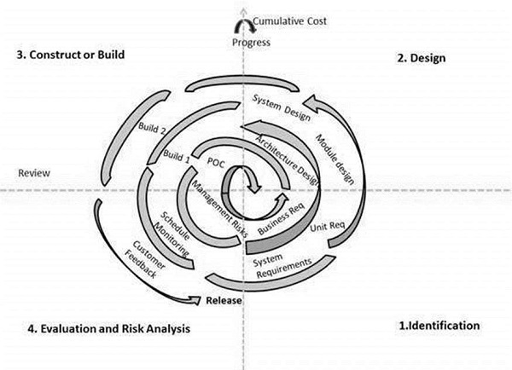

Slide 10
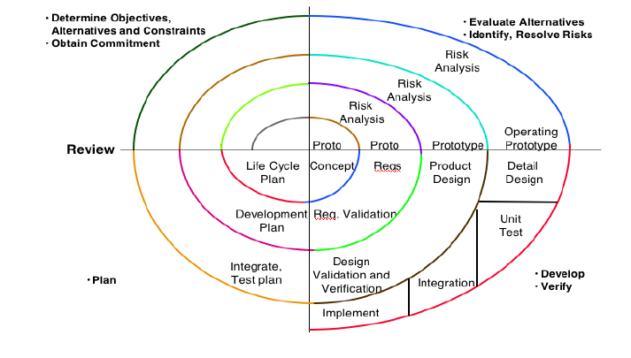
Spiral Model

Slide 11
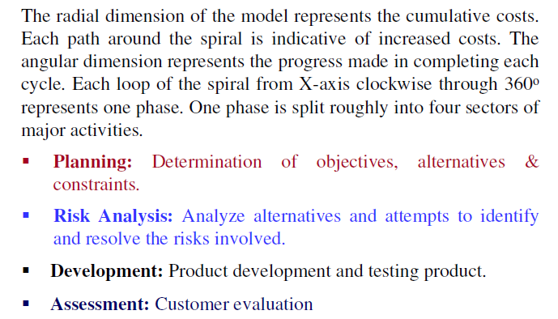
Spiral Model

Slide 12
The advantages of the Spiral SDLC Model are as follows −
Changing requirements can be accommodated.
Allows extensive use of prototypes.
Requirements can be captured more accurately.
Users see the system early.
Development can be divided into smaller parts and the risky parts can be developed earlier which helps in better risk management.

Slide 13
The disadvantages of the Spiral SDLC Model are as follows −
Management is more complex.
End of the project may not be known early.
Not suitable for small or low risk projects and could be expensive for small projects.
Process is complex
Spiral may go on indefinitely.
Large number of intermediate stages requires excessive documentation.

Slide 14
The Unified Process
The Unified Process (UP), or Unified Software Development Process, is a iterative and incremental software development framework from which a customized process can be defined.
The framework contains many components and has been modified a number of times to create several variations. The most popular variations include the Rational Unified Process (RUP) and the Open Unified Process (OpenUP). The framework has several key characteristics which seem to carry across all variations (as far as I can tell).

Slide 15
The key characteristics of the Unified Process are :
It is an iterative and incremental development framework.
It is architecture-centric with major work being done to define and validate an architectural design for most coding is done.
It is risk-focused and emphasizes that highest-risk factors be addressed in the earliest deliverables possible
It is use-case and UML model driven with nearly all requirements being documented in one of those forms

Slide 16
In general, the Unified Process is built around the idea of incorporating six specific best practices into a configurable process framework. Those best practices are:
Develop Software Iteratively
Manage Requirements
Use Component-based Architectures
Visually Model Software
Verify Software Quality
Control Changes to Software

Slide 17
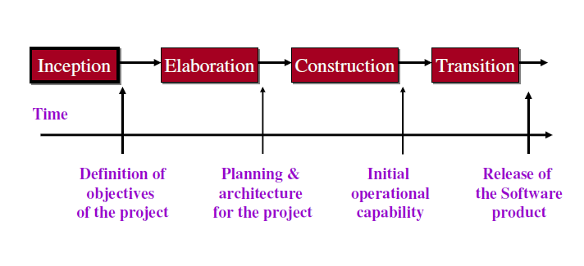
Phases of the Unified Process

Slide 18
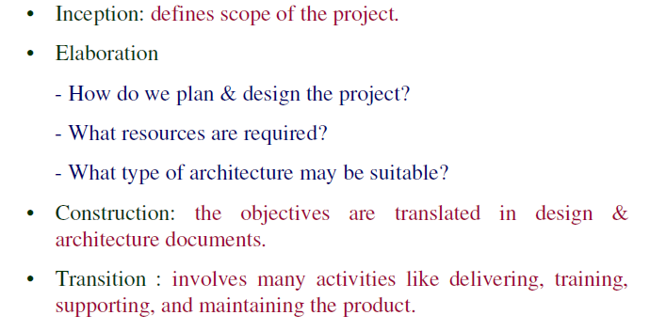
Phases of the Unified Process

Slide 19
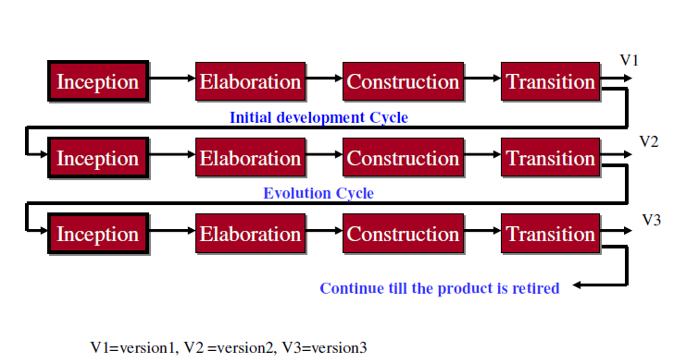
Initial development & Evolution Cycles

Slide 20
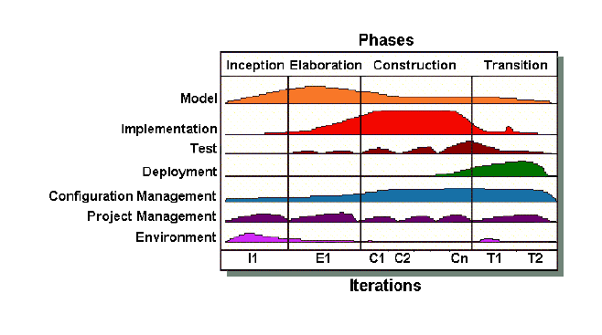
Iterations & Workflow of Unified Process

Slide 21
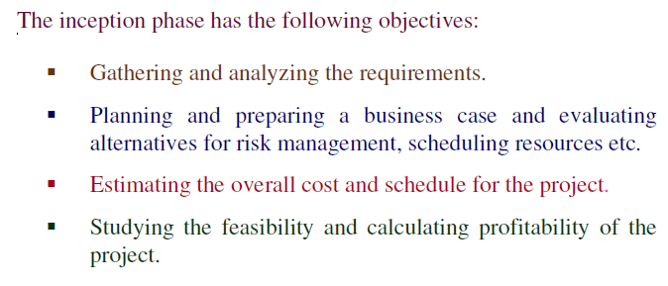
Inception Phase

Slide 22
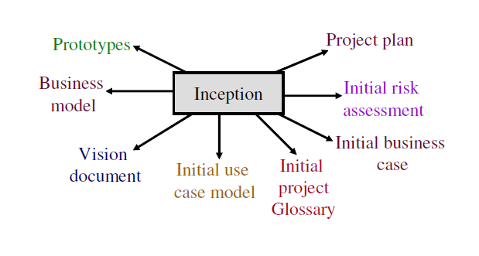
Outcomes of Inception Phase

Slide 23
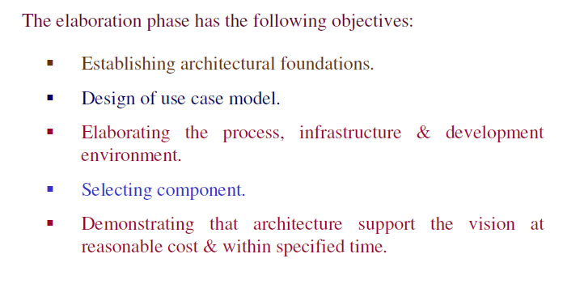
Elaboration Phase

Slide 24
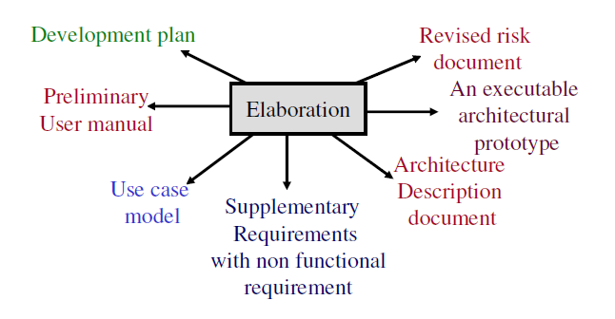
Outcomes of Elaboration Phase

Slide 25
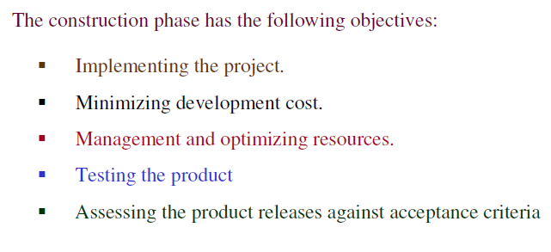
Construction Phase

Slide 26
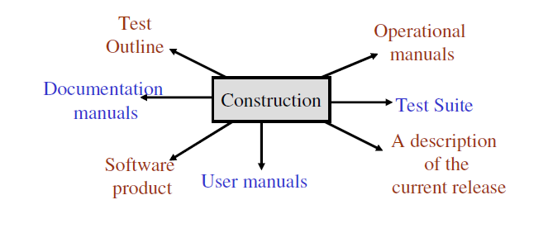
Outcomes of Construction Phase

Slide 27
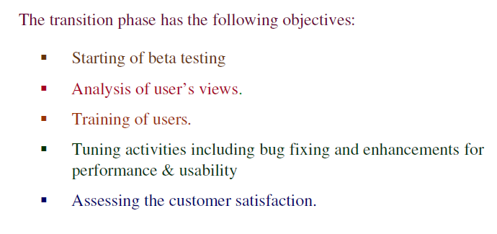
Transition Phase

Slide 28
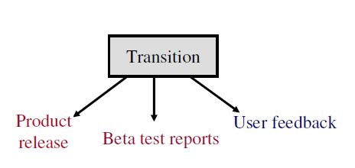
Outcomes of Transition Phase

Slide 29
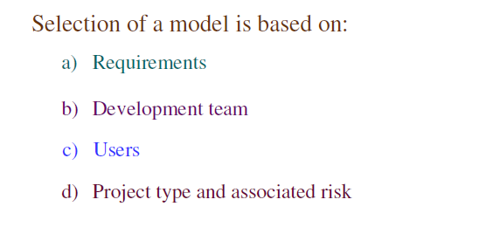
Selection of a Life Cycle Model

Slide 30
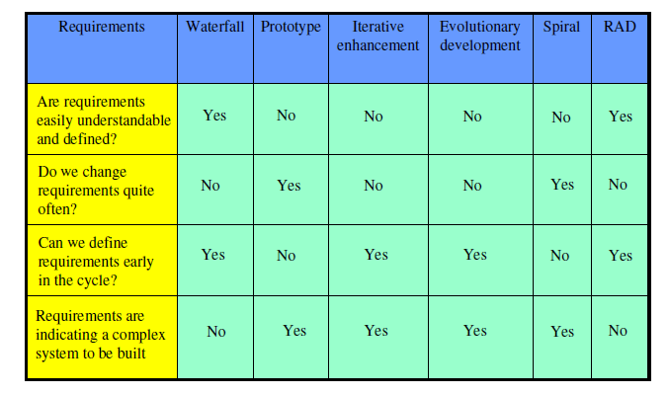
Based On Characteristics Of Requirements

Slide 31
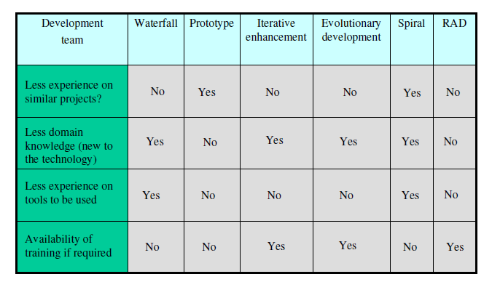
Based On Status Of Development Team

Slide 32
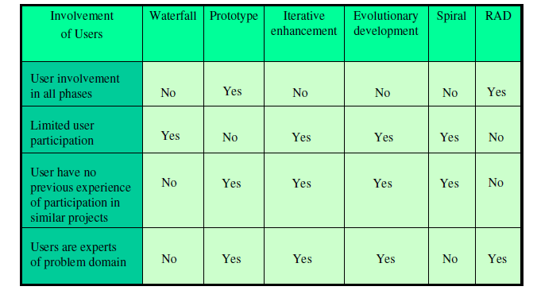
Based On User’s Participation

Slide 33
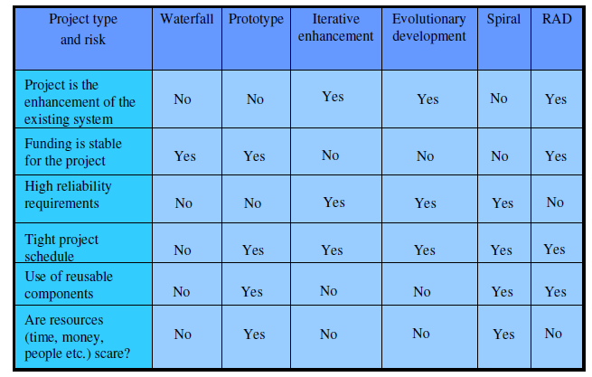
Based On Type Of Project With Associated Risk

Slide 34
QUESTIONS
Q-1. Spiral Model was developed by
Bev Littlewood
Berry Boehm
(c) Roger Pressman
(d) Victor Basili
Q-2. Which is not a software life cycle model?
Waterfall model
(b) Spiral model
(c) Prototyping model
(d) Capability maturity model

Slide 35
Q-3. Which one is the most important feature of spiral model?
Quality management
Risk management
(c) Performance management
(d) Efficiency management
Q-4. If user participation is available, which model is to be chosen?
Waterfall model
Iterative enhancement model
(c) Spiral model
(d) RAD model

Slide 36
Q-5. The outcome of construction phased can be treated as:
Product release
Beta release
(c) Alpha release
(d) All of the above

Slide 37
THANK YOU

